Slide 1

Summer Internship Project
Indian Institute of Information Technology Sonepat
Submitted To: Dr. Rajiv Verma

Slide 2
Introduction
Name: Dipankar Yadav
Roll Number: 12111070
Department: Computer Science and Engineering

Slide 3

Summer Internship Details
Company Name: Ask Senior
Role : Teaching Assistant
Duration: 3 Months +
ABOUT:
Founded in January 2023, the Senior - DCD Discord Server offers Daily Contest Discussions (DCDs) to anyone who wants them. We are now a successful community of contributors with a lot going on. The DCDs for Codeforces, Codechef, and at times Atcoder and Leetcode are also available. As part of our mentoring program, we organize regular sessions.

Slide 4
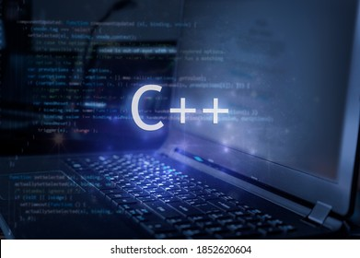

My Role at AskSenior
Internship Experience : Ask Senior
Resolved over 100+ doubts related to DSA/CP
Utilized strong problem-solving skills to address a variety of challenges posed by students.
Resolved the maximum number of doubts in batch 3
Techstack:

Slide 5
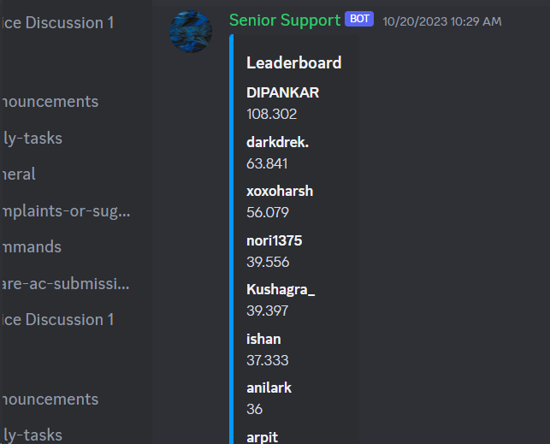
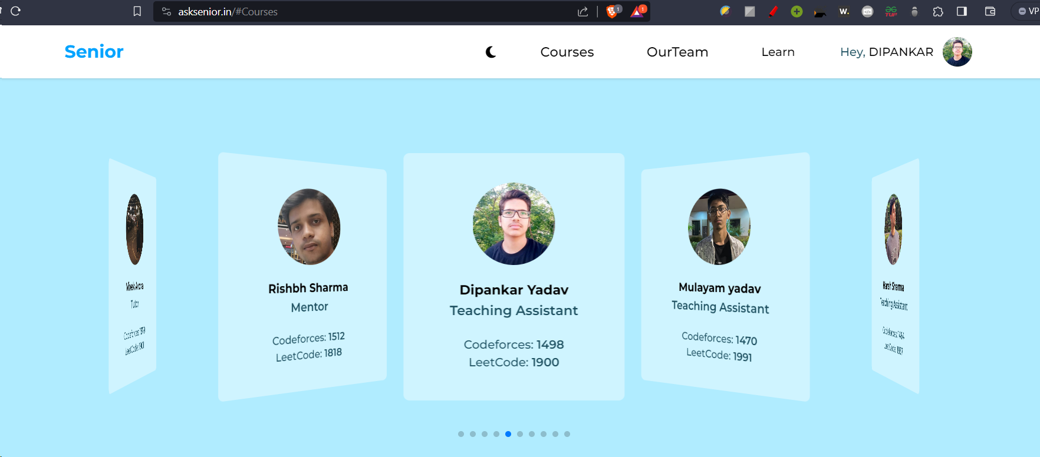
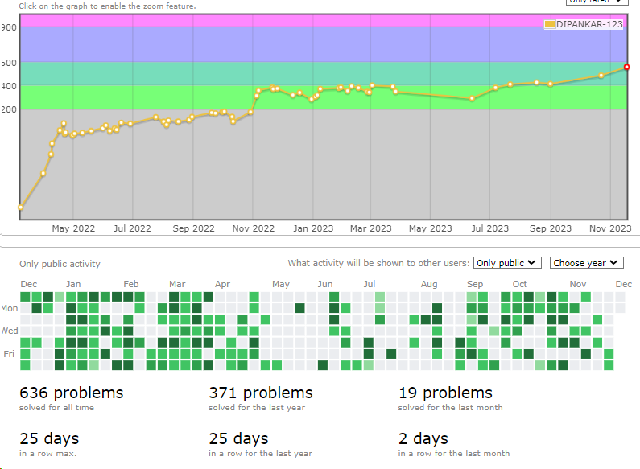
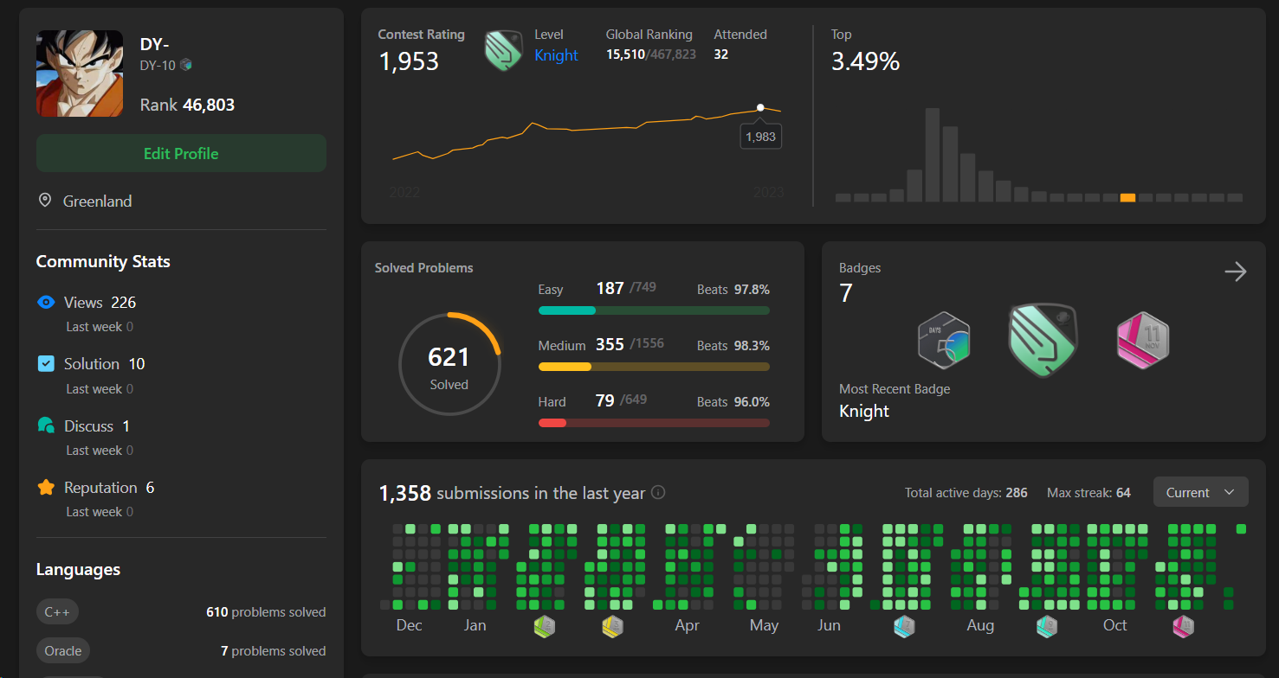
My Work at AskSenior

Slide 6

Summer Internship Details
Company Name: AIChefMaster
Role : Frontend Developer
Duration: 1 Month +
ABOUT:
At AIChefMaster we revolutionize cooking and catering services with our AI chef, access to diverse international recipes, and exceptional catering solutions. Our AI chef offers personalized guidance, diet plans, diverse recipes, and real-time assistance, making cooking a breeze. We simplify recipe adaptation based on ingredient availability, ensuring a creative and varied culinary experience. Our catering services are designed to elevate your special occasions with exquisite culinary offerings. Collaborating with local caterers and expert chefs, we create a customized menu that reflects your unique taste and style. Explore a wide range of diverse international recipes with House of Dishes. Our curated collection includes flavors and techniques from various cultures, allowing you to embark on a culinary journey without leaving your kitchen.

Slide 7





My Role at AIChefMaster
Internship Experience : AichefMaster
Developed the website’s dashboard and implemented authentication, seamlessly integrating them with the backend.”
Implemented the ’Forgot Password’ feature
Developed the career page from scratch
Techstack:

Slide 8
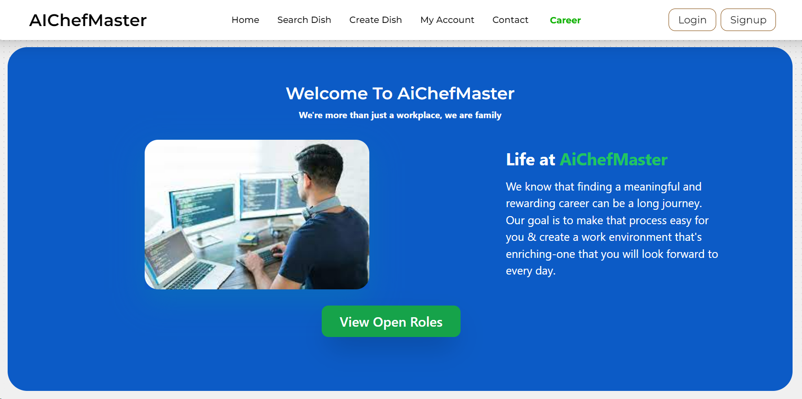
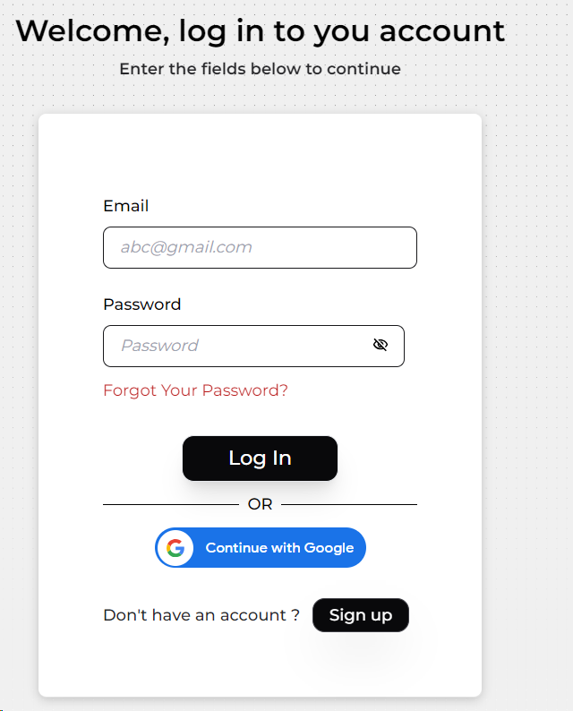
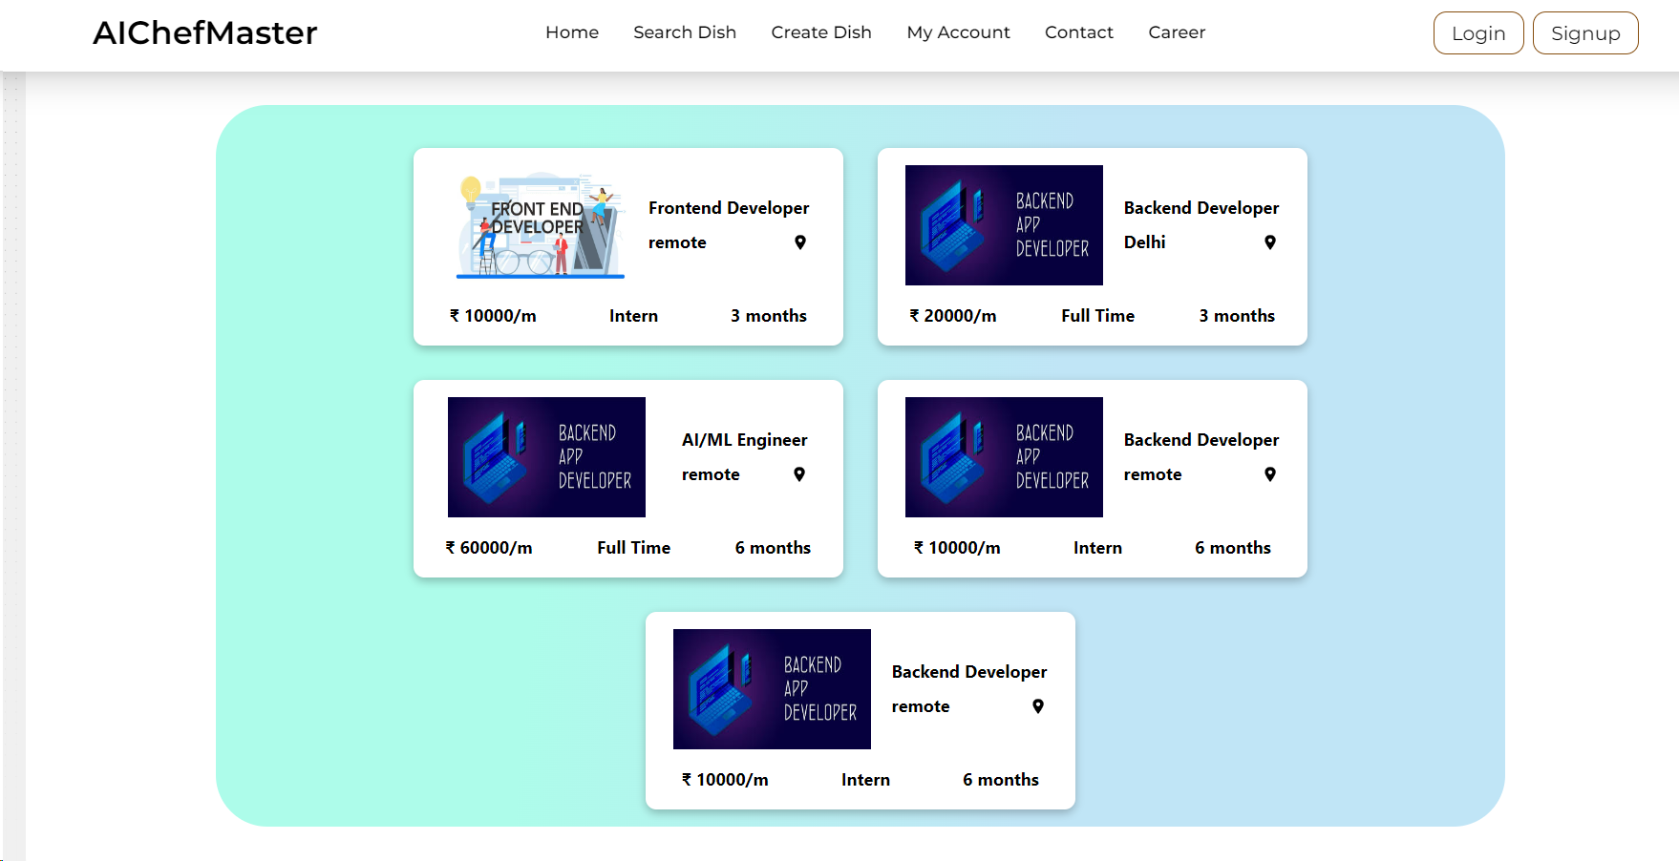
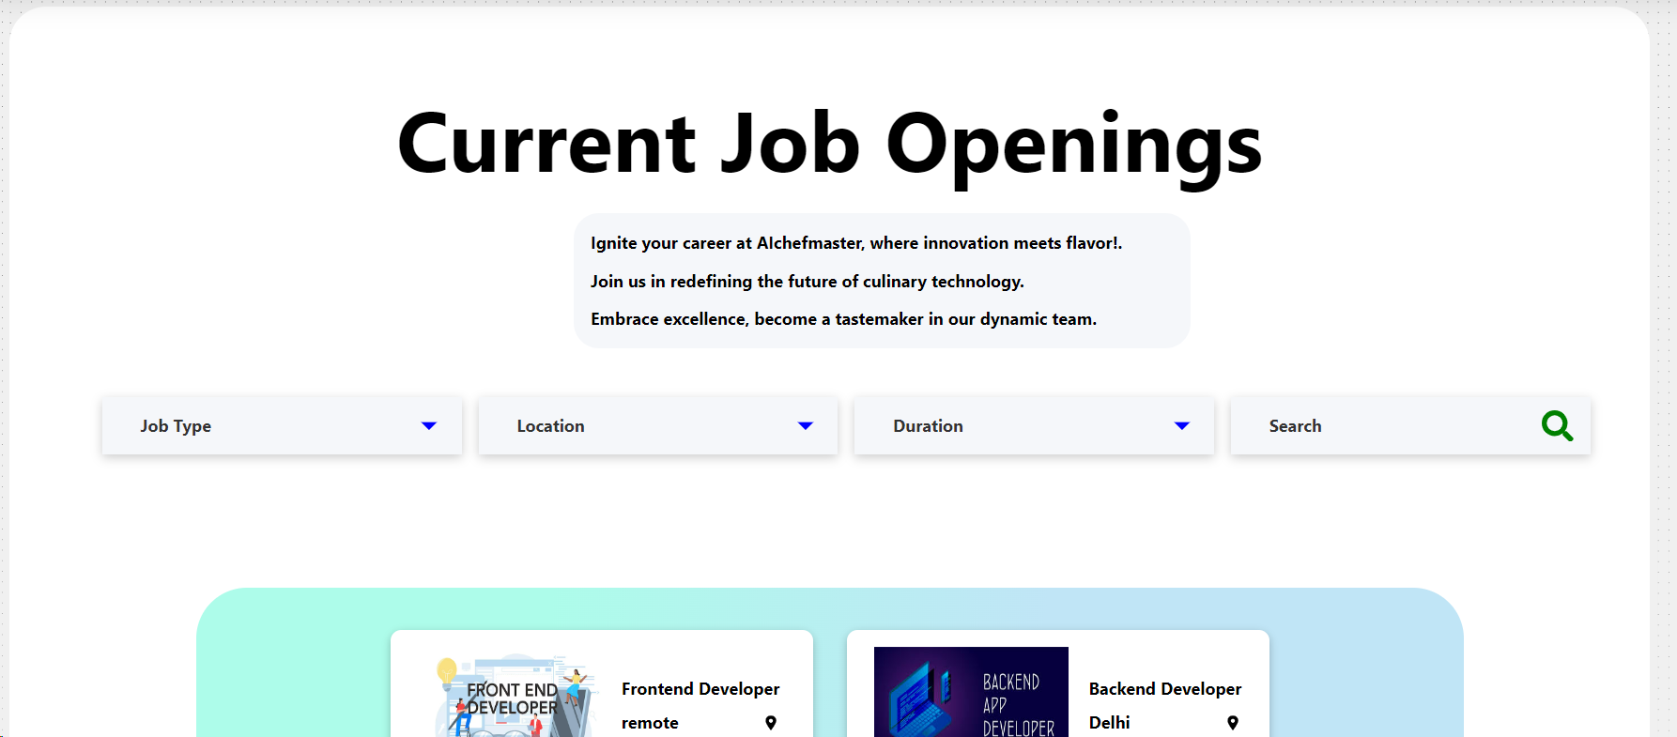
My Work at AIChefMaster

Slide 9
Course Introduction
Course Name: The Complete JavaScript Course
Course Instructor: Jonas Schmedtmann
Course Platform: Udemy
Course Duration: 68.5 hours
Course Name: The Ultimate React Course
Course Instructor: Jonas Schmedtmann
Course Platform: Udemy
Course Duration: 67 hours

Slide 10

Front-End Development
Front-end development focuses on creating the user interface and experience of websites and web applications. Using HTML, CSS, and JavaScript, front-end developers craft visually appealing and interactive elements, ensuring a seamless user journey. They leverage frameworks like React or Angular to enhance efficiency and collaborate with back-end developers to deliver fully functional, modern web solutions.

Slide 11

JS
JavaScript is a versatile programming language commonly used for web development. It enables dynamic and interactive content on websites, enhancing user experience.
As a client-side scripting language, it runs in web browsers, allowing manipulation of HTML and CSS to create dynamic web pages. JavaScript supports event-driven programming, enabling actions in response to user interactions. With the advent of Node.js, JavaScript can also be used for server-side development.
Its wide range of libraries and frameworks, such as React and Angular, simplifies building complex applications. JavaScript's asynchronous nature enhances performance by handling multiple tasks simultaneously.

Slide 12

React JS
React is a powerful JavaScript library for building user interfaces. Developed and maintained by Facebook, React simplifies the process of creating interactive and dynamic UIs by using a component-based architecture. Its virtual DOM system enhances performance, and the introduction of React Hooks has streamlined state management. Widely adopted in web development, React is known for its declarative syntax, reusability, and efficient rendering, making it a go-to choice for building modern and responsive applications.

Slide 13
Tech Stack Learned

Slide 14



Redux
React Router
React

Slide 15


React Query
Tailwind CSS
Vite

Slide 16
Deployment Tools

Slide 17



Git Hub
Netlify
Vercel

Slide 18
Course and Intern Certificate

Slide 19
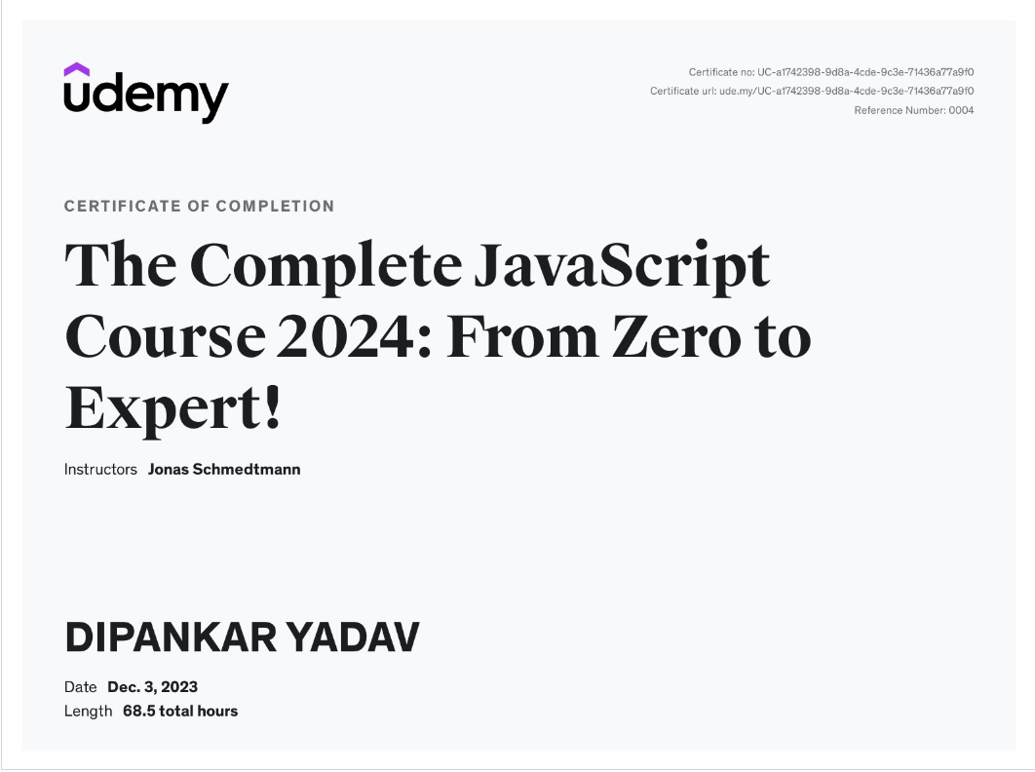

Slide 20
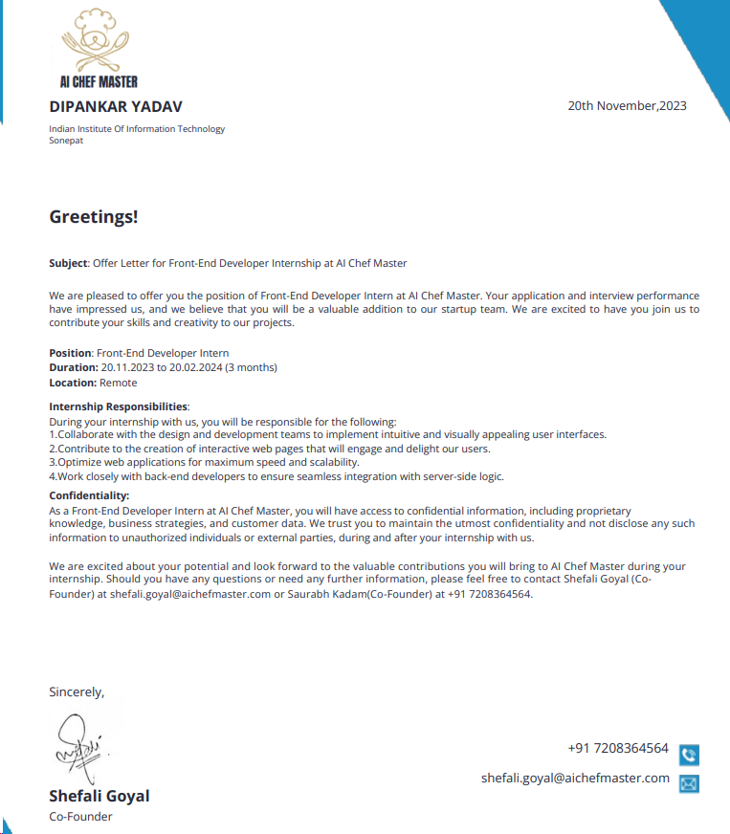

Slide 21
Thank You

